Slide 1
PROJECT PYTHON: CAR RENTING SYSTEM

Slide 2
HELLO!
THIS PROJECT WAS MADE BY A TEAM OF ENTHUSIASTS, WE ARE:
BOLATULY ARMAN
NGUYEN HUY HIEU
TLEKTESSOV TEMIRLAN

Slide 3
1.
PURPOSE.

Slide 4
MAIN PURPOSE
Create a program for renting🔑
Make it simple
User friendly👤

Slide 5
2. Functionality.

Slide 6
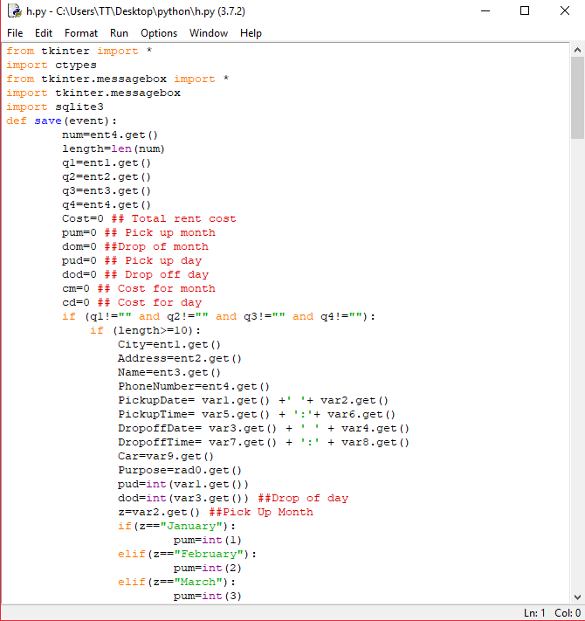
MAIN FUNCTIONS
Libraries:
Tkinter
Sqlite3
Ctypes

Slide 7
3.
Algorithms.

Slide 8
MAIN ALGORITHMS
Registration
User information registration and storing it in database(SQL).
Finding
Finding user information by their phone number.
Deleting
We can manage the data from database by deleting user information and etc.

Slide 9
LET’S REVIEW EVERYTHING
Purpose
To create a user-friendly program for car renting.
Functions
We used tkinter for GUI, sqlite to store data and ctypes to C compatible data types.
Algorithms
Registration, finding and deleting information.
Purpose
Program should be easy to use and flexible for modifying.
Functions
Do not use too much functions to keep code clear and editable.

Slide 10
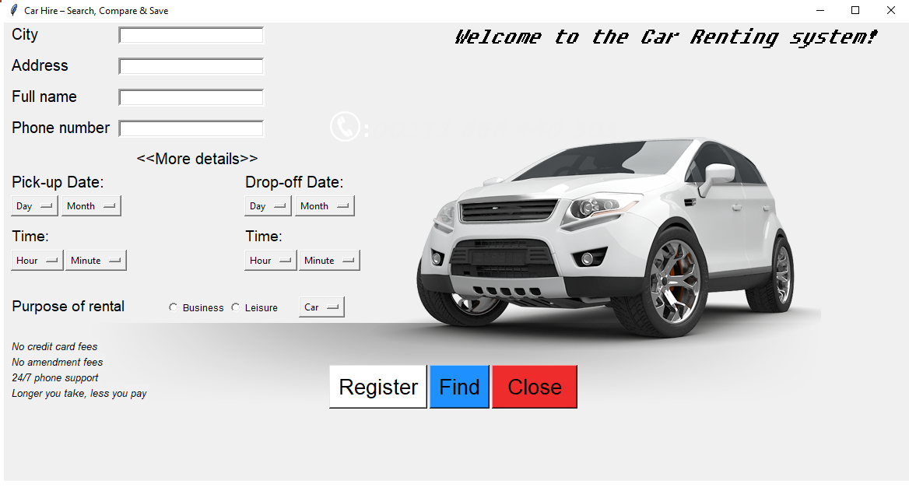
Main Menu
Place your screenshot here

Slide 11
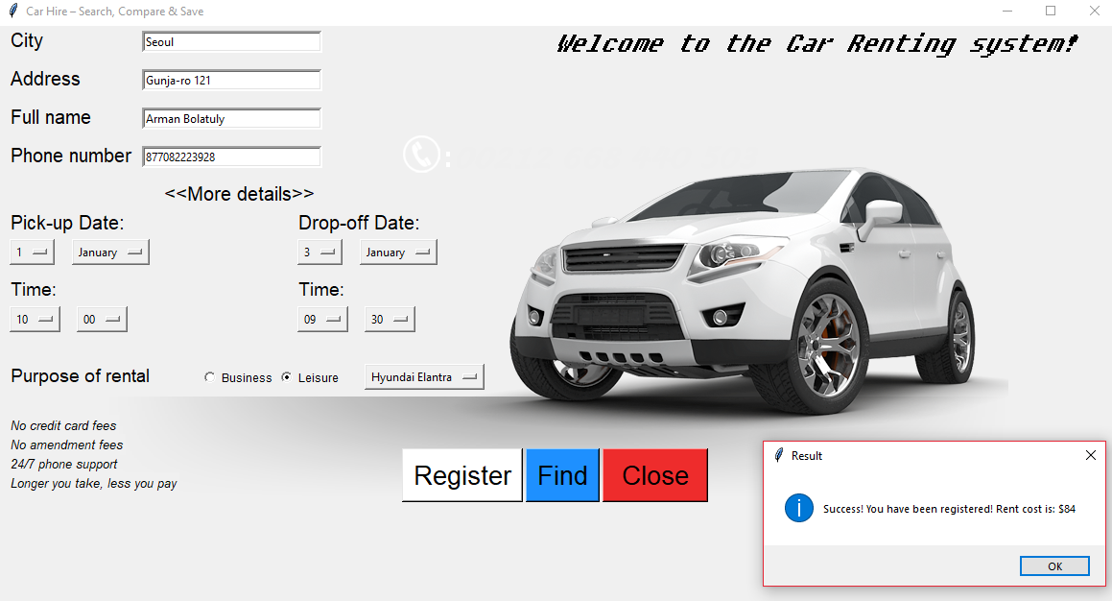
Registration Success
Place your screenshot here

Slide 12
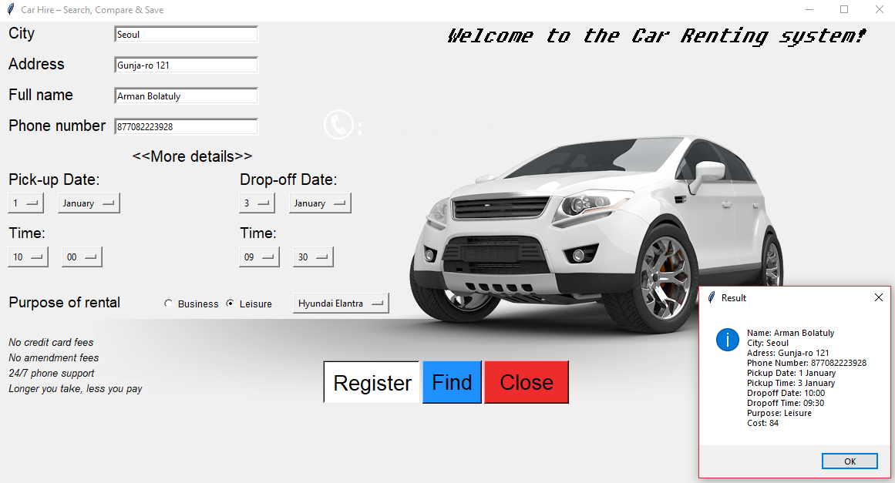
Finding User Information
Place your screenshot here

Slide 13
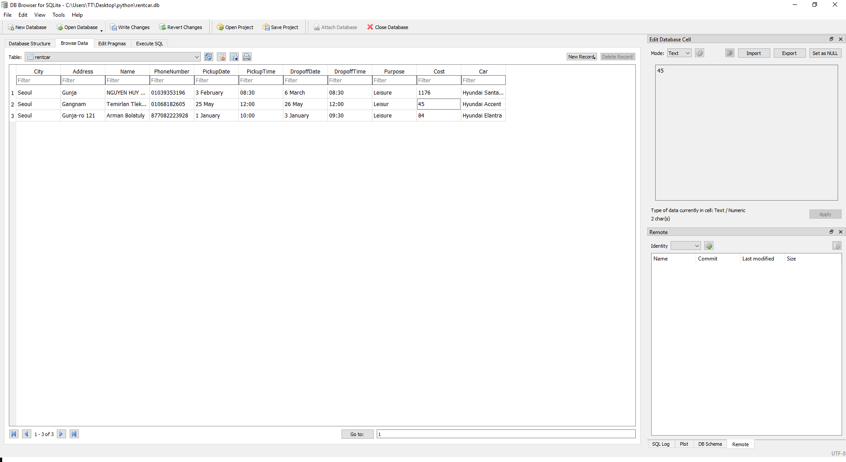
SQL
Place your screenshot here

Slide 14
THANK YOU FOR ATTENTION!
Any questions?

Slide 15
SlidesCarnival icons are editable shapes. This means that you can:
Resize them without losing quality.
Change fill color and opacity.
Change line color, width and style.
Isn’t that nice? :) Example:

Slide 16
😉
Now you can use any emoji as an icon! And of course it resizes without losing quality and you can change the color. How? Follow Google instructions https://twitter.com/googledocs/status/730087240156643328
✋👆👉👍👤👦👧👨👩👪💃🏃💑❤😂😉😋😒😭👶😸🐟🍒🍔💣📌📖🔨🎃🎈🎨🏈🏰🌏🔌🔑 and many more...

